Slide 1
Revenue Manager Pricing Strategy

Slide 2

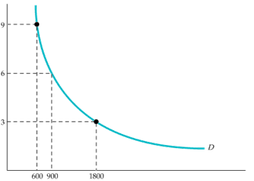
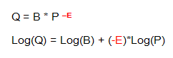
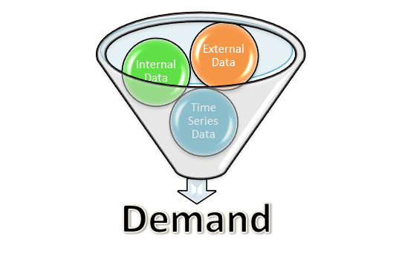
Elasticity Model
Log linear regression model to estimate demand elasticity
  Use historical price/quantity data to understand demand patterns
  Assumption is isoelastic demand (constant elasticity at all price points)
  Coefficient of natural log of price represents elasticity estimate
  To improve model predictive power, we control for non own-price effects
  External influences of Demand
    Changes to competitor prices (cross price elasticity)
    Changes to discretionary income (income effect)
    Macroeconomic effects (potential substitute effects)
  Internal influences of Demand
    Changes to internal competitor prices (cross price elasticity)
    Changes to marketing campaigns
    OTB Pacing / mix changes by channel
  Seasonal influences of Demand
    Weekday/Weekend effects
    Month/season effects
    Holiday effects

Slide 3

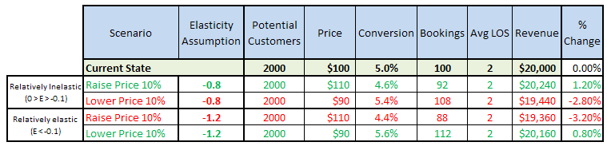
Price Elasticity Strategy
Price elasticity of demand
  Price elasticity of demand is an economic measure to understand customer demand sensitivity to price changes
  The formal definition is elasticity equals change in quantity divided by change in price
    For example, an elasticity = -2 = 2% divided by -1% => a 1% drop in price yields 2% increase in quantity
  If elasticity is between 0 and -1, demand is “inelastic” (customer is relatively insensitive to price changes)
  If elastic is smaller than -1, demand is “elastic” (customer is relatively sensitive to price changes)
Implications for Hotel revenue opportunities
  The table below represents increased revenue opportunities given an understanding of demand elasticity
Optimum Strategy: If demand is inelastic, raise prices. If demand is elastic, lower prices

